Slide 1
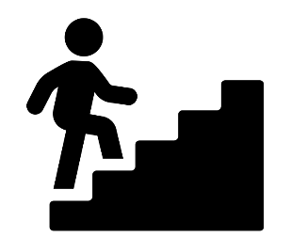

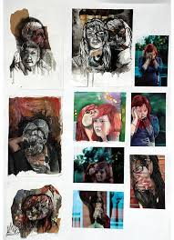
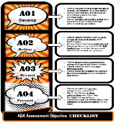
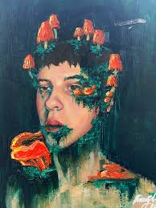
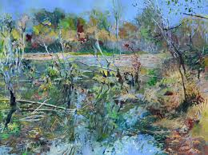
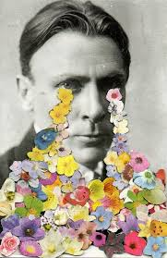
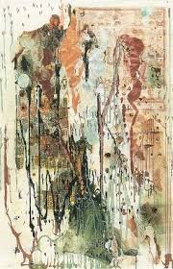

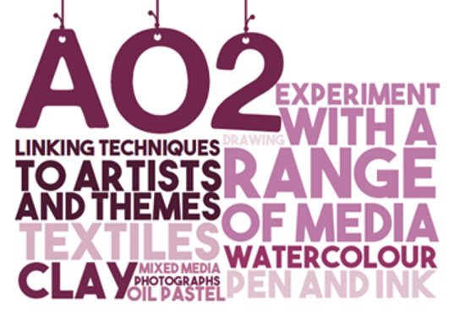
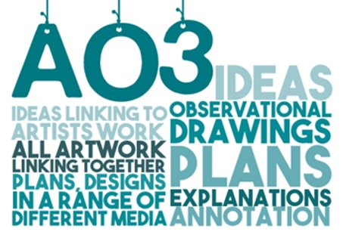
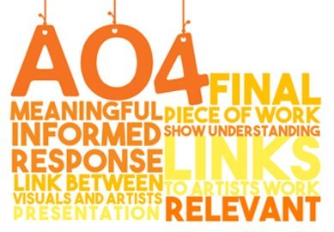
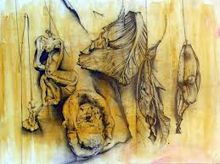
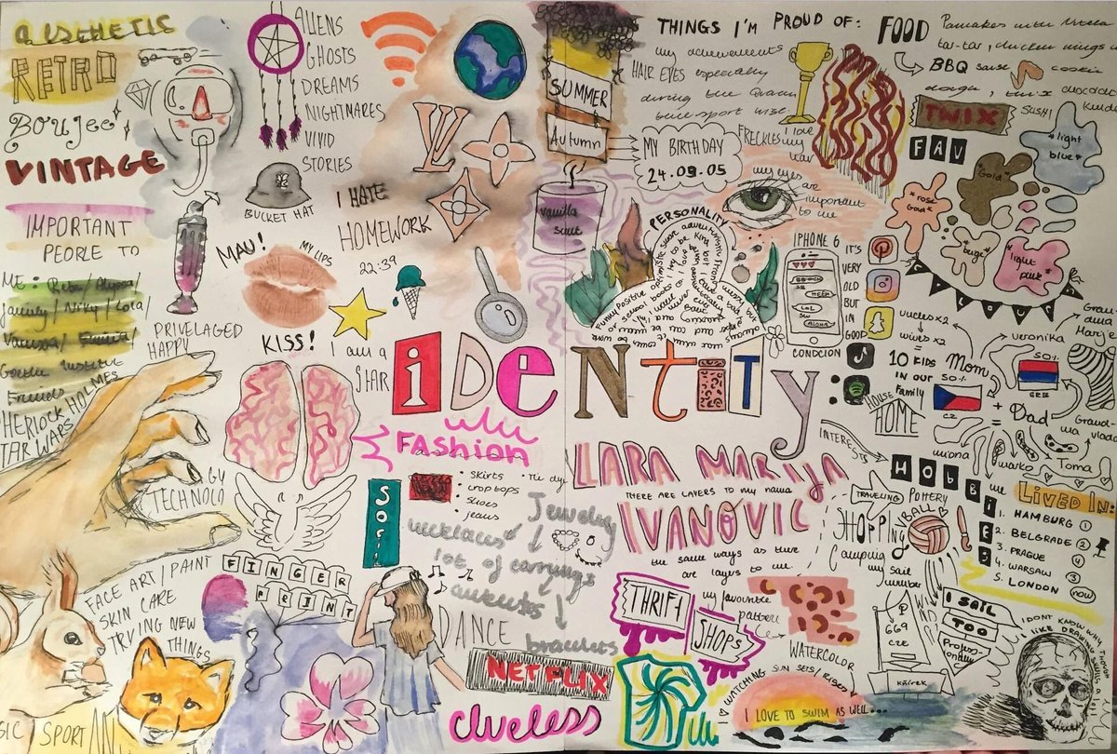
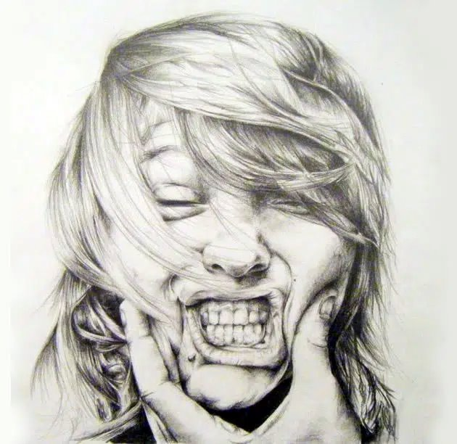
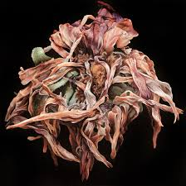
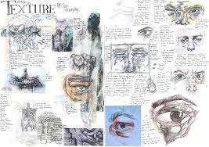
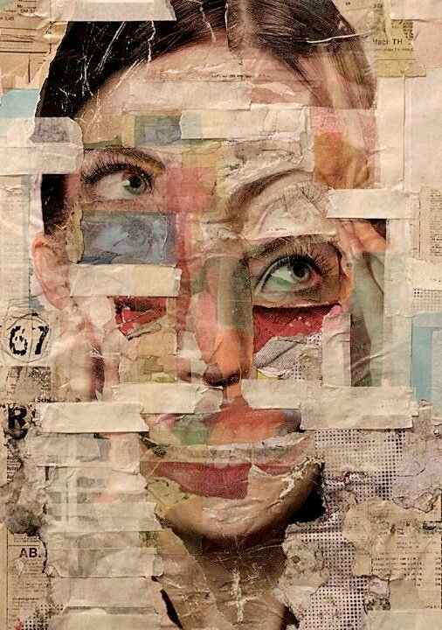
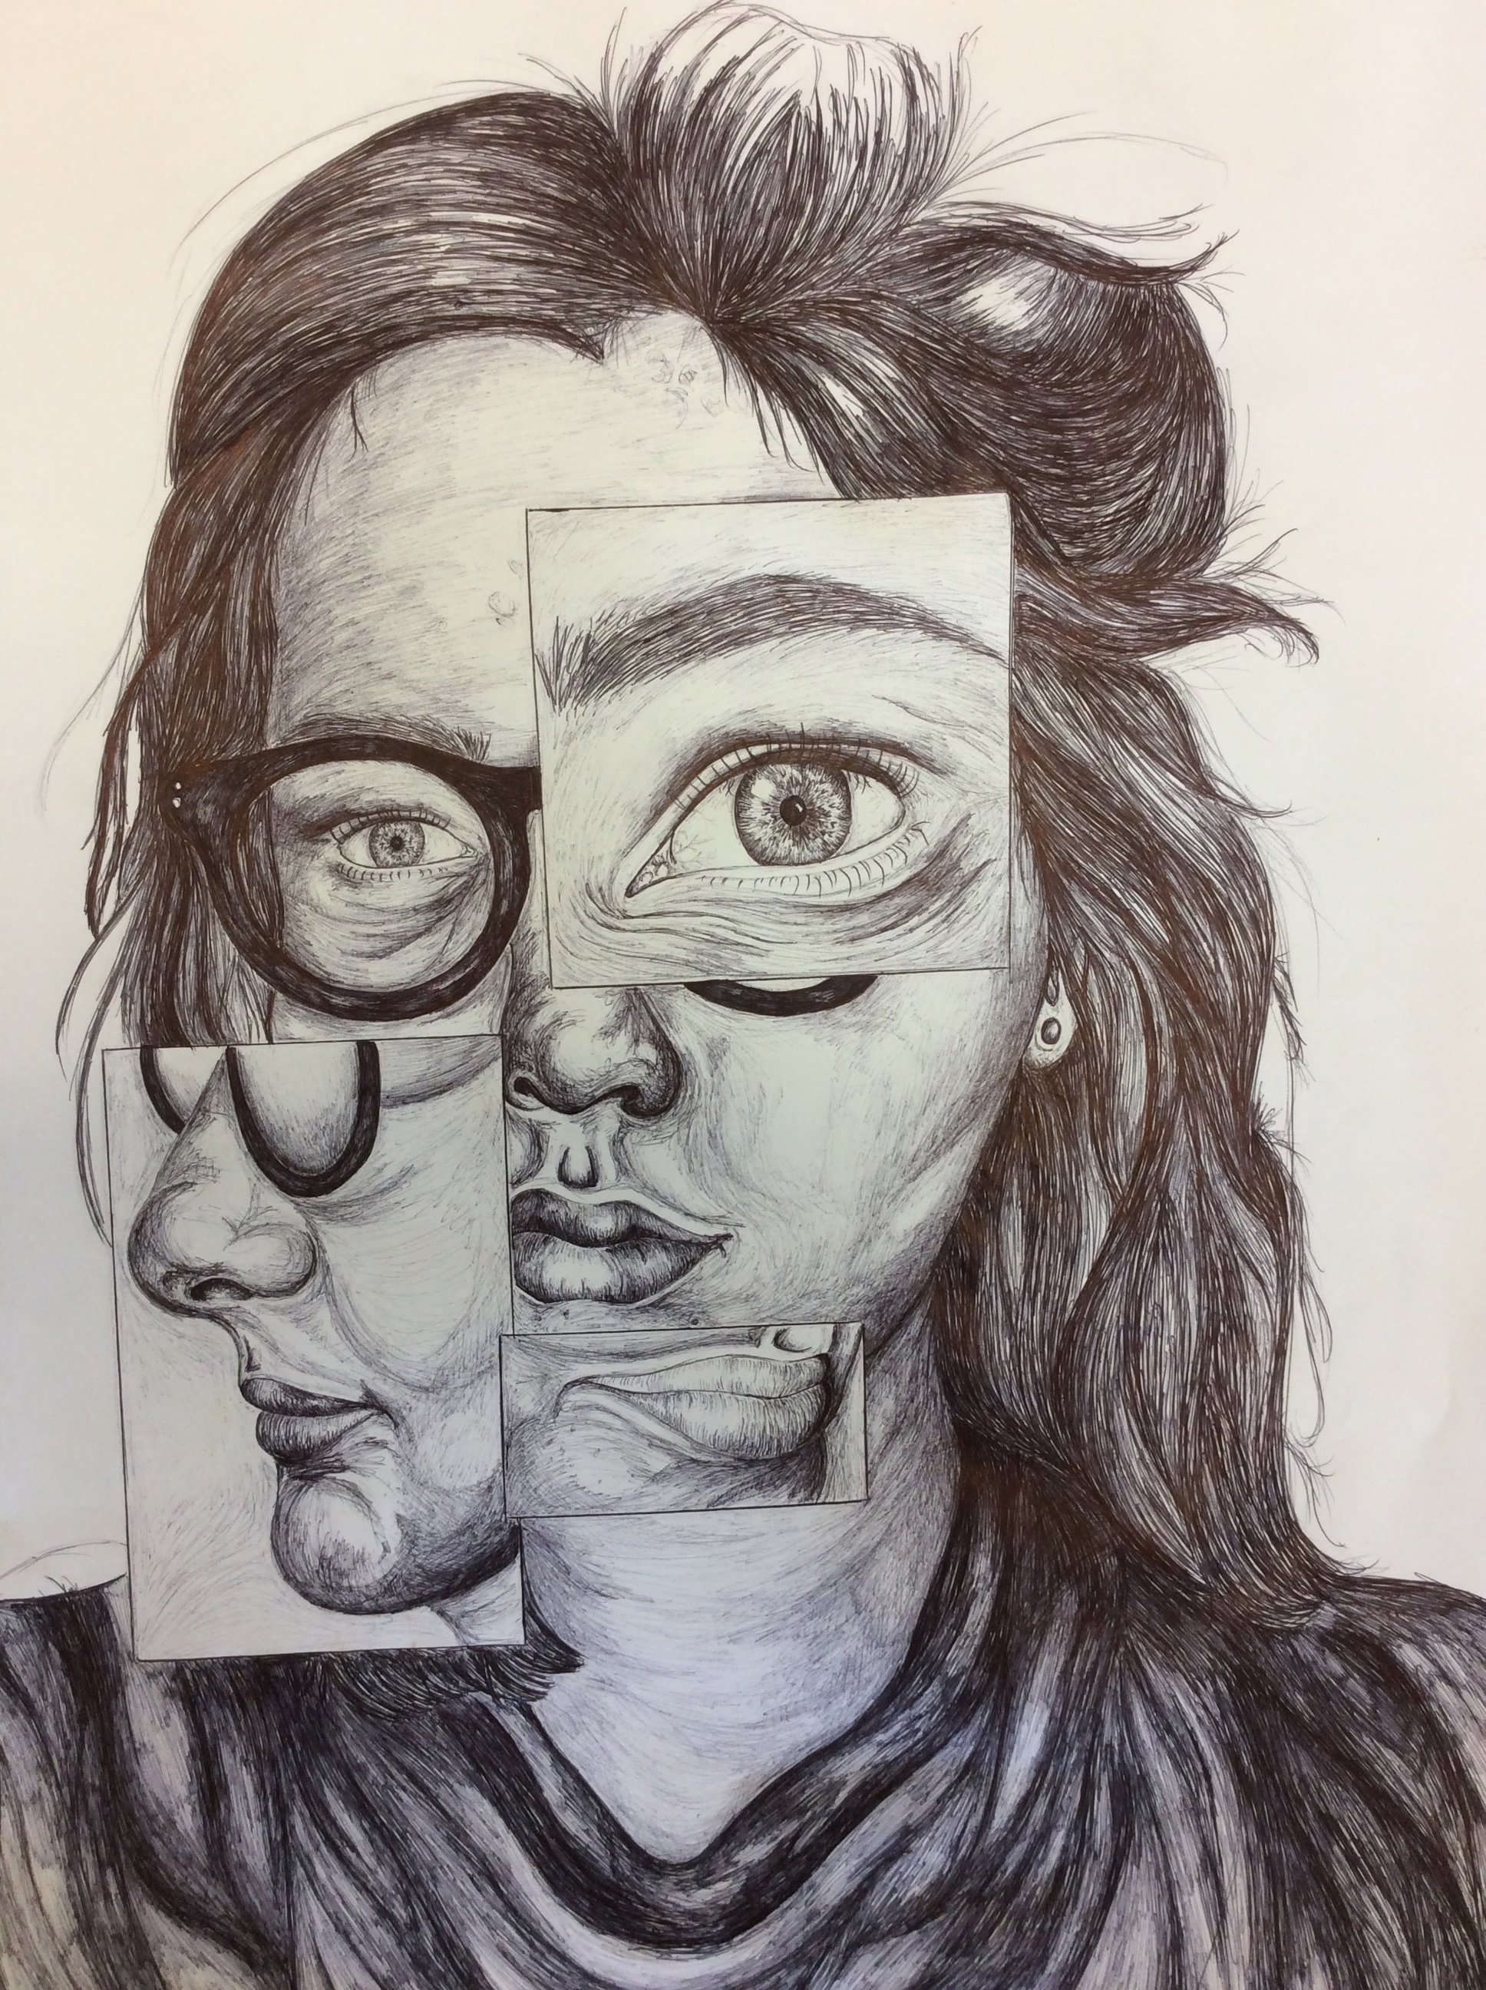
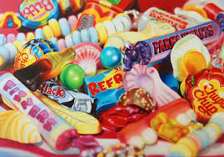
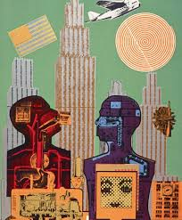
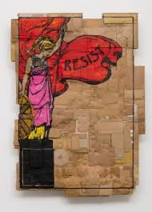
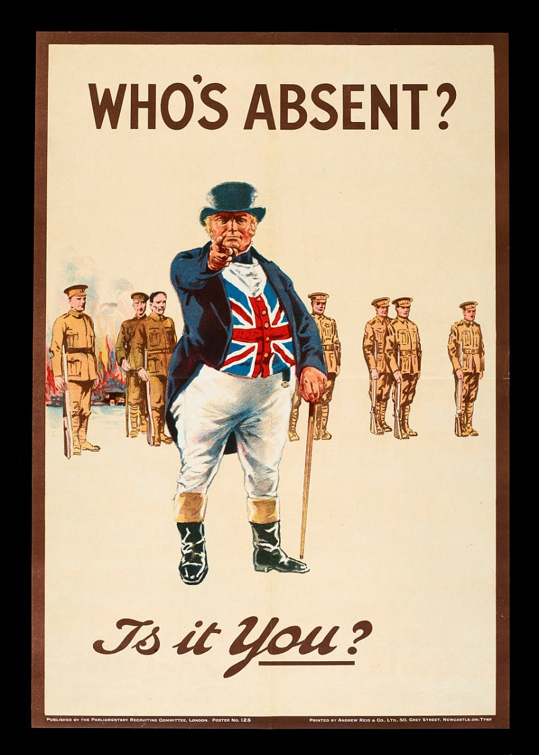
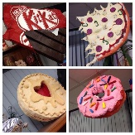
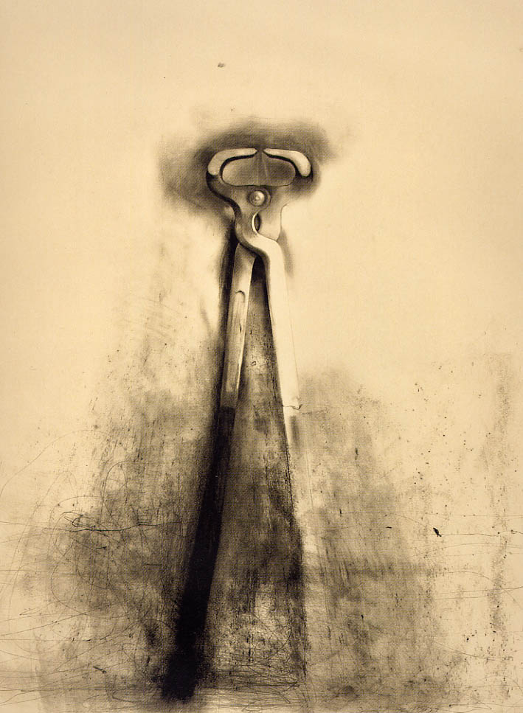
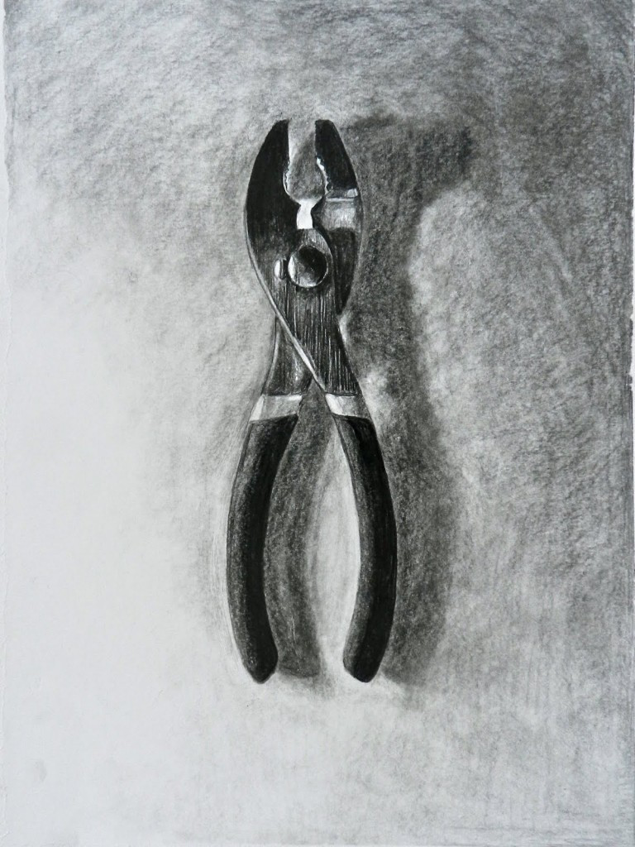
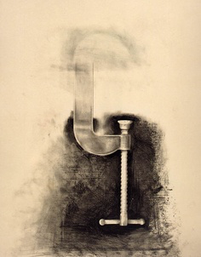
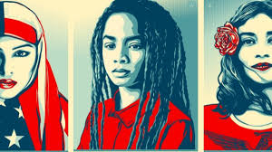
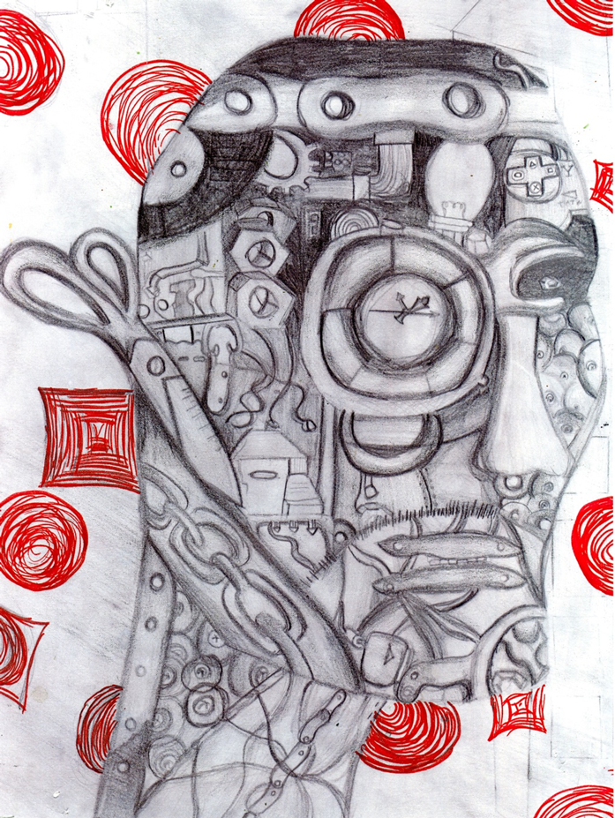
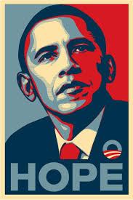
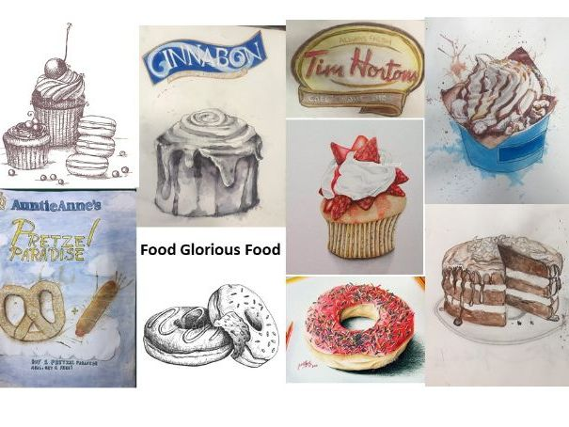

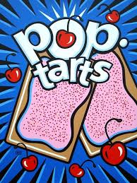
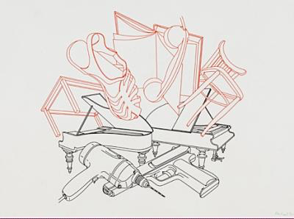
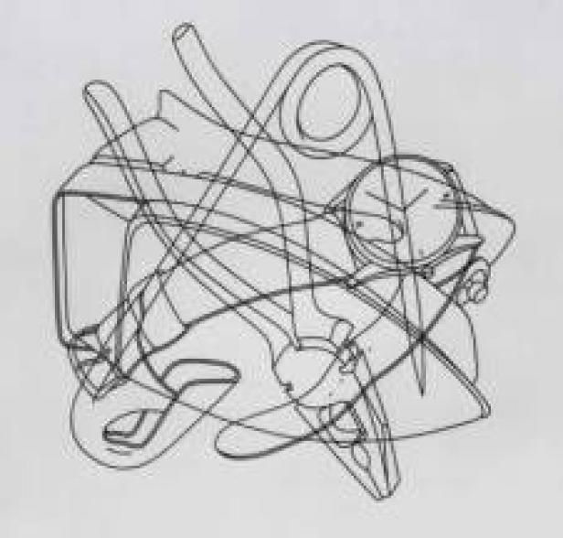
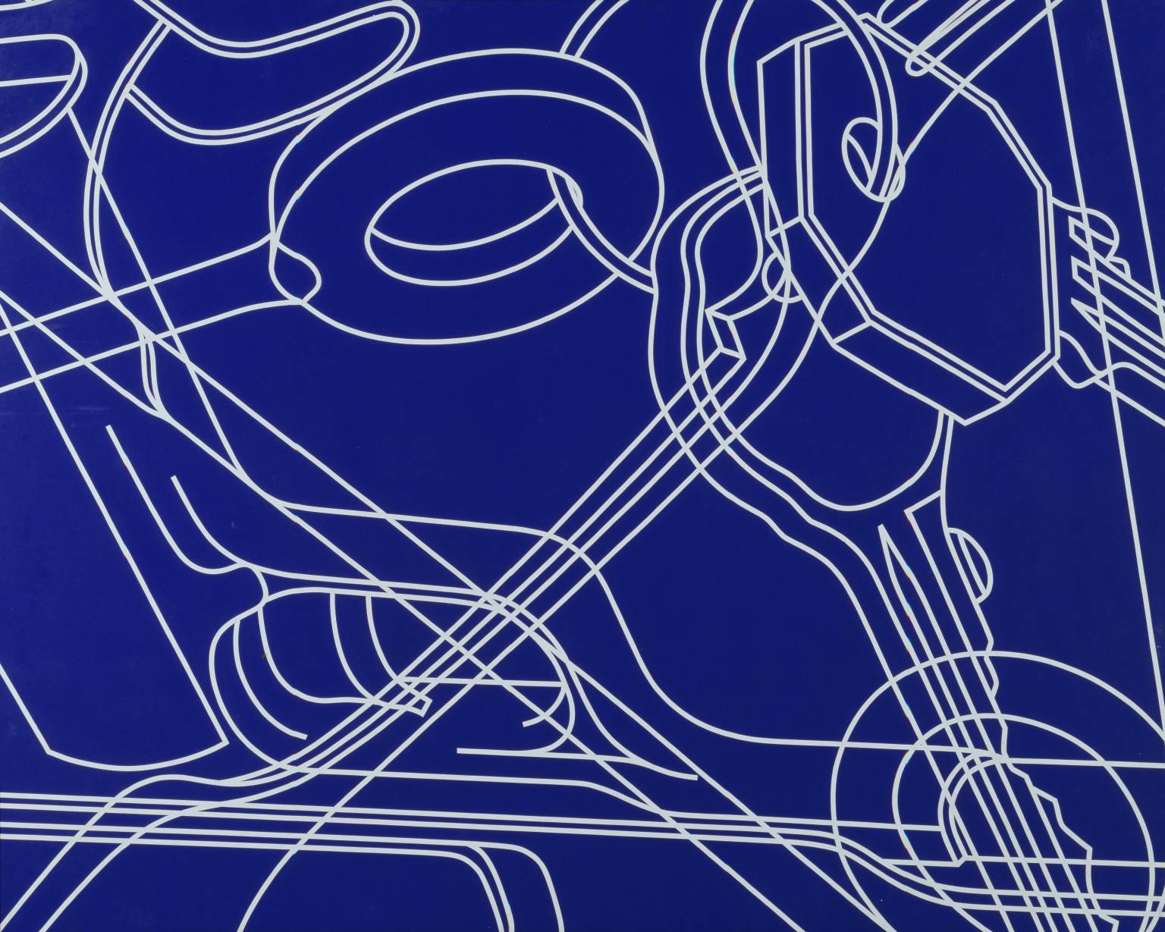
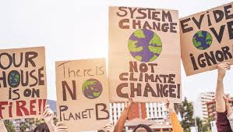
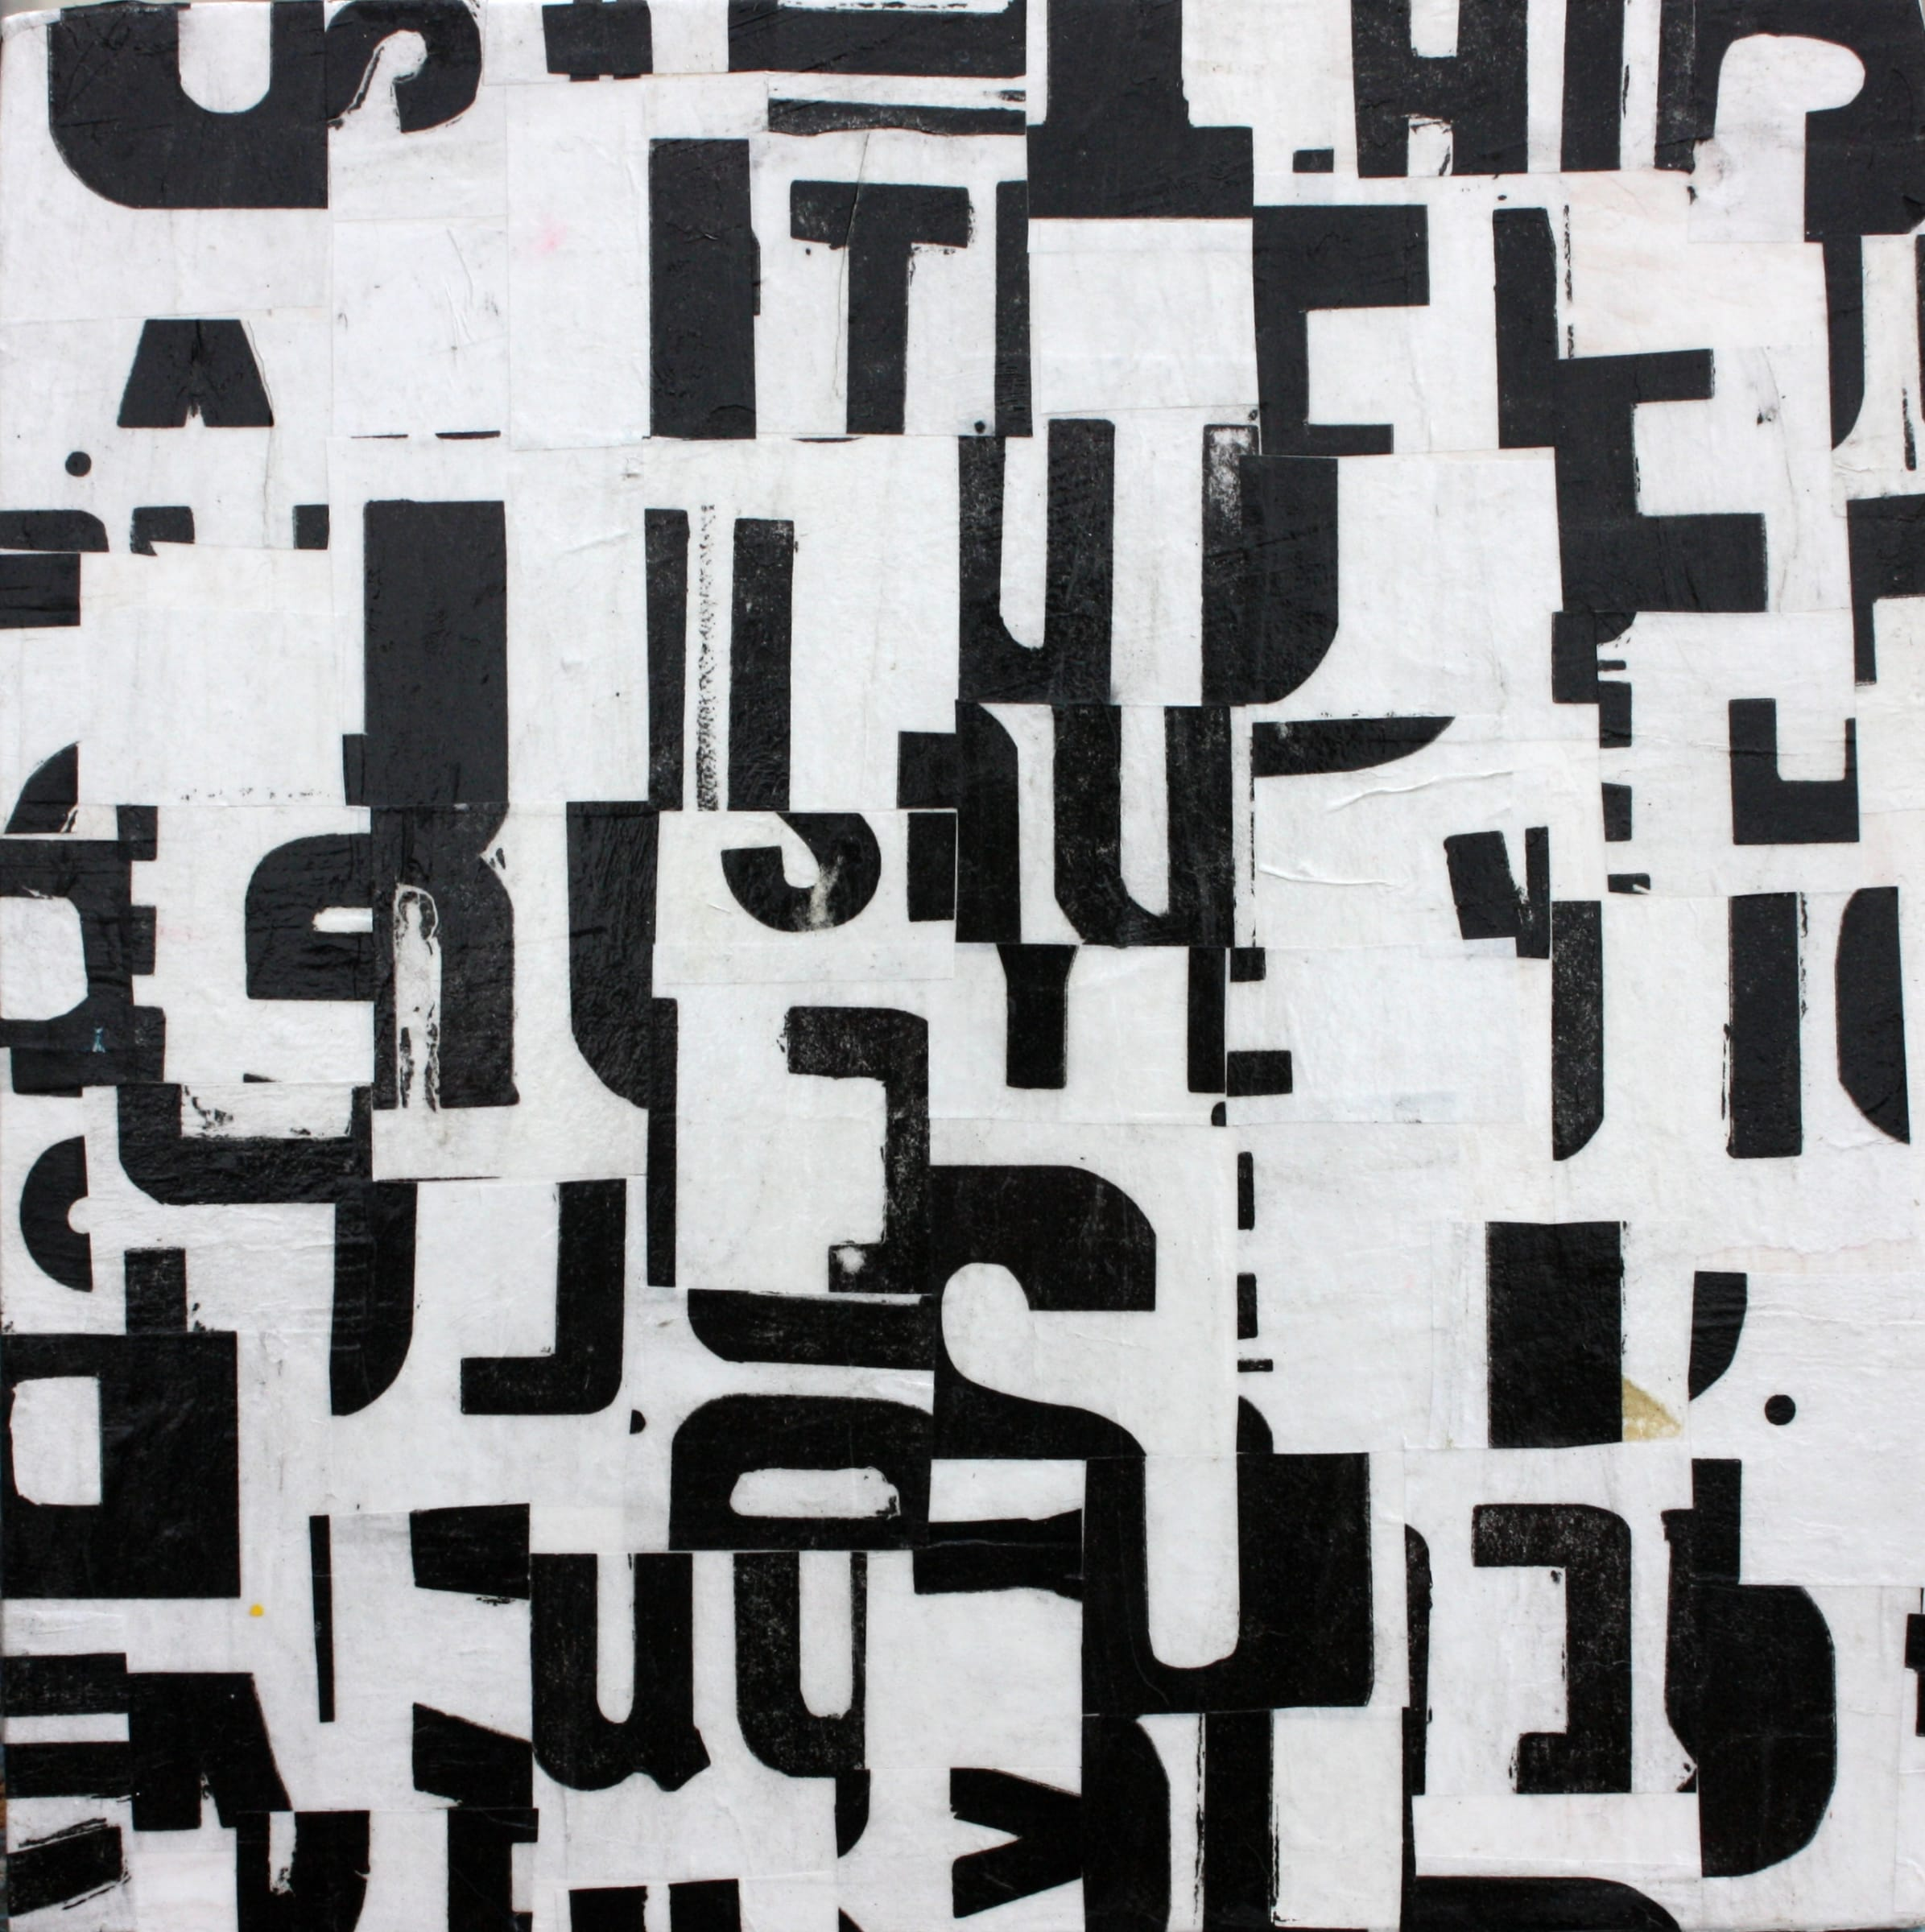
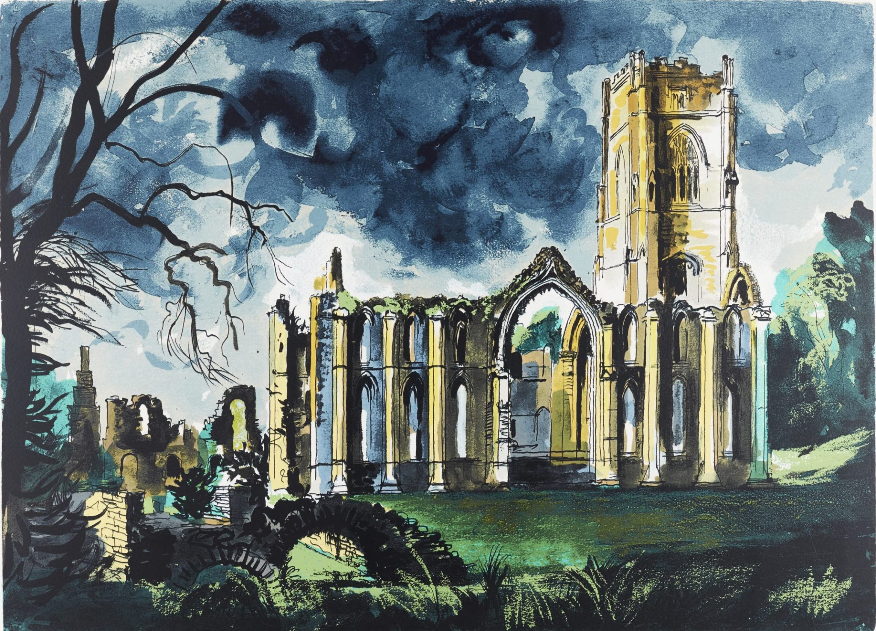
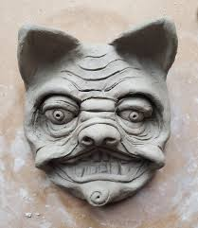
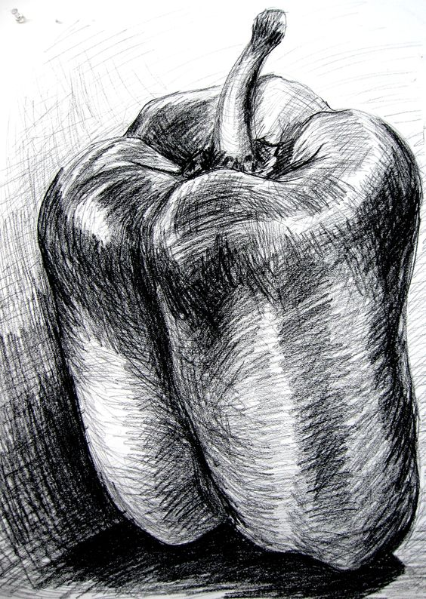
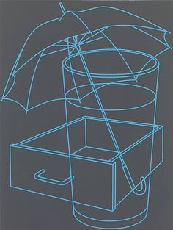
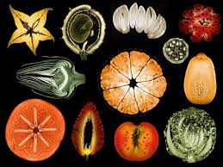
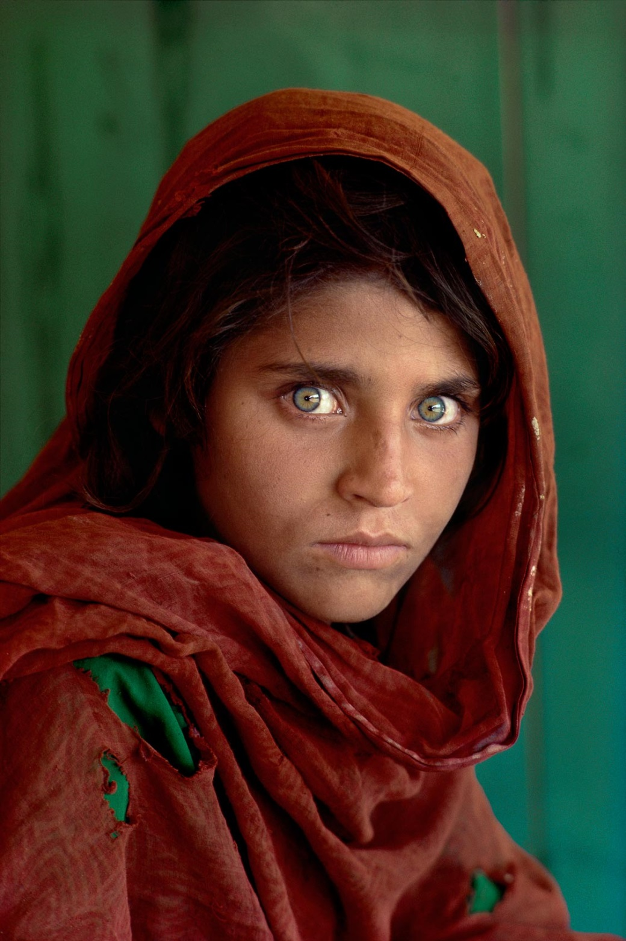
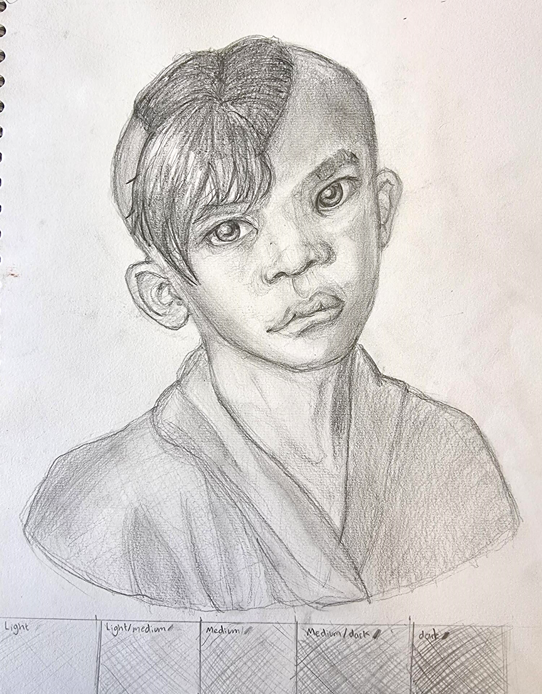
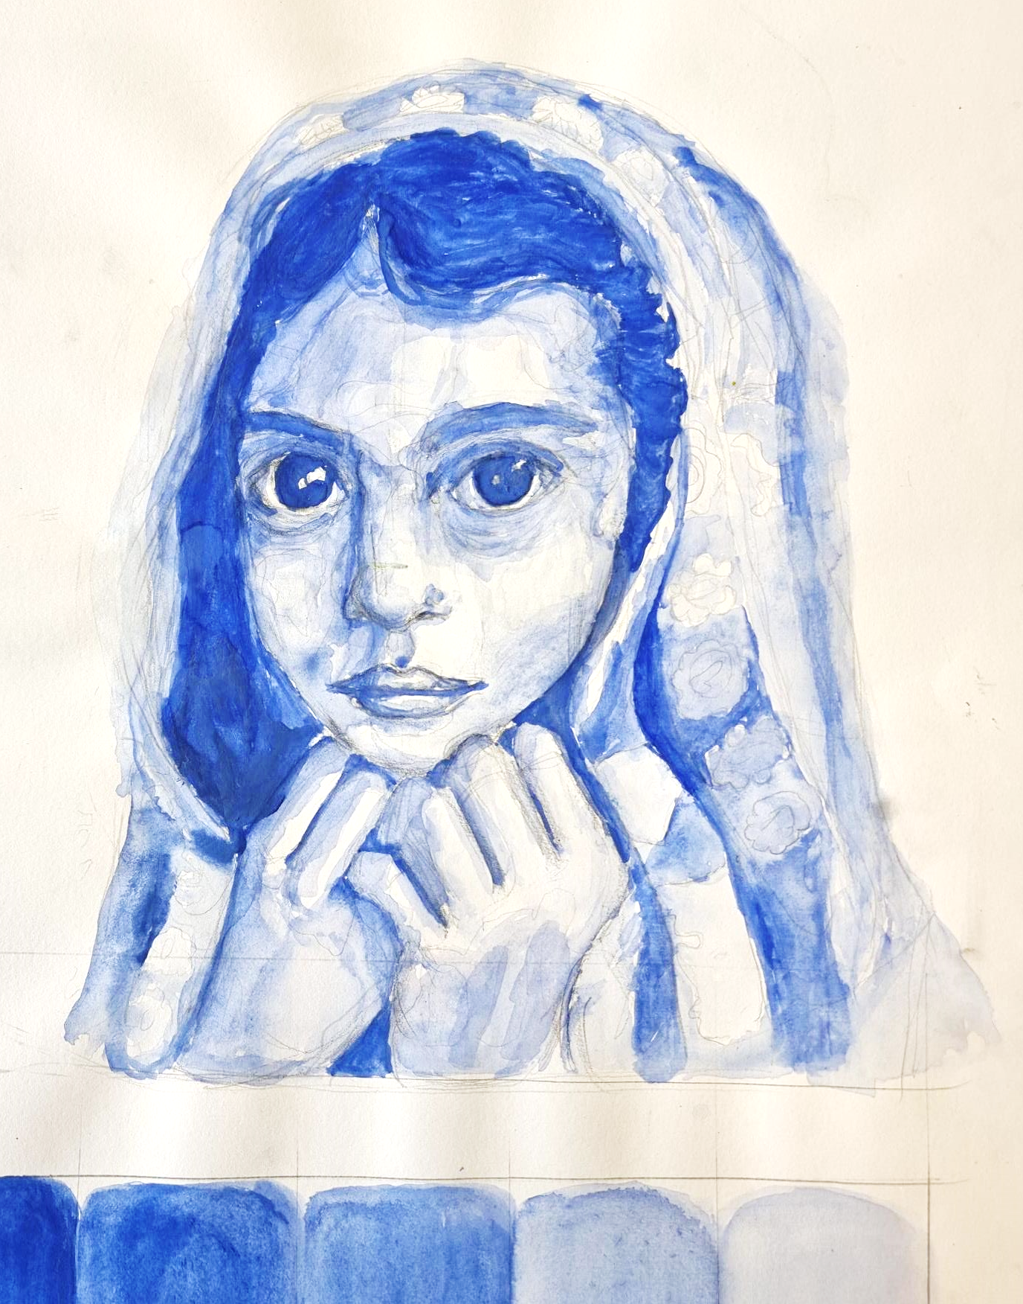
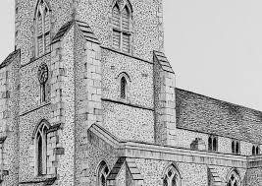
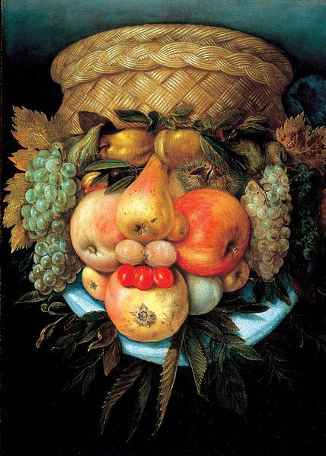
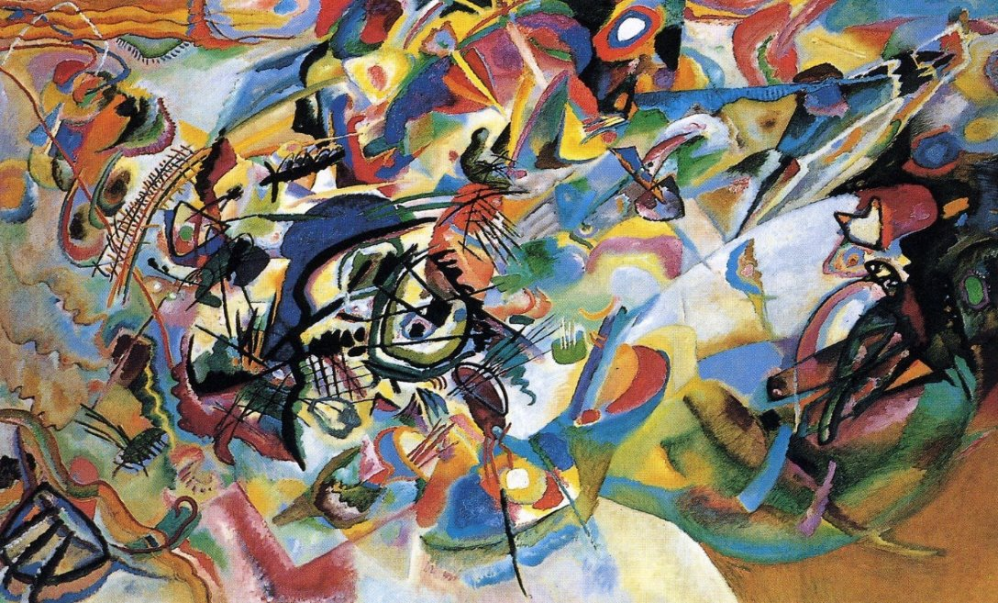
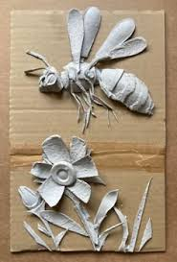
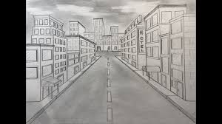
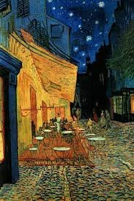
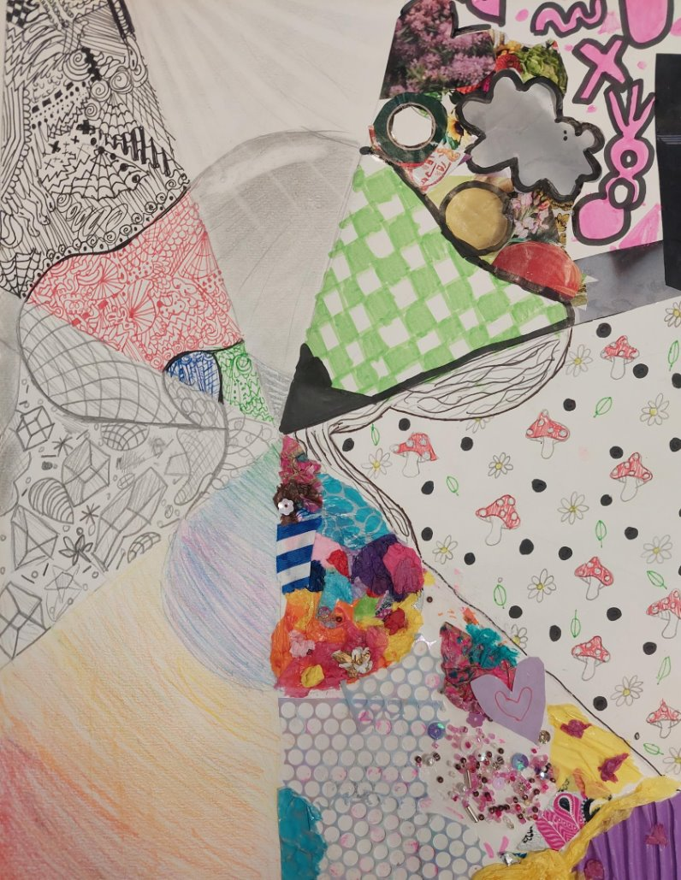













External Component
February 40% Exam
Exam paper given out
Observational drawings, using a variety of materials
Discussion of final outcomes for exam-working to students strengths
Final pieces produced, course work handed in and mounted
Discussion of exam paper
Making sure assessment objectives are being developed and answered in preparatory work
External Exam
April -end of course
Discussion of final outcomes for courses work-working to students strengths
Summer work set , continuation of personal project and preparing for conclusions to personal project.
Students working though assessment feedback ensuring assessment objectives are answered.
Interview ready-portfolio
Structure of essay to run alongside personal project
Past examples given out
How to present a portfolio of work answering the 4 assessment objectives. Presentation and mounting up.
YEAR
How to present a portfolio of work-presentation and mounting up.
13
Personalized feedback/checklists for coursework
Continue to work on personal project
Summer work
presented
Developing
Personal projects to ensure experimentation
Developing understanding of how to develop ideas, experiment with materials and review work, and to record from it.
Course Introduction, breakdown of course, introducing of A 'Level assessment objectives. 60% coursework, 40% Exam
TERM 1
Workshop based lessons encouraging experimentation within the summer project theme and 'Growth and Decay'
Recording of aspects of the theme through 1st hand photography
Observational drawings, using a variety of materials
External Exam -end of course
YEAR
12
Using Assessment to ensure assessment objectives are being developed and answered
TERM 2
Personal projects
Students select a theme for the independent project
Discussion of final outcomes for courses work-working to students strengths
Growth and Decay.
What does you ‘Growth and Decay’ mean to you?
Work shops continue in the lessons
Observational drawings, using a variety of processes/materials
Developing portfolio, building on strengths
Discussion of exam paper
December- Coursework mounted and handed in
Discussion of final outcomes for courses work-working to students strengths
Continuation of Project 2
External Component 40% Exam
Exam paper given out
Completion of final pieces for Course work
Developing understanding of assessment objectives
11
Starting point
Building on existing skills composition of collage based on objects reflecting interests and personality
Introducing new processes and using different materials informed by collage - shapes, letter and numbers.
Observational drawings, using a variety of materials
Discussion of final outcomes for courses work-working to students strengths
Research/Investigate Artists inspired by selected theme
Investigating Designers.
cultural, personal identity-
Inking to careers development.
Experimentation
Development of ideas
Identity
September- February
Course Introduction, breakdown of course, introducing of GCSE assessment objectives. 60% coursework, 40% Exam
Observing and recording through own photographs
Project 2
February-Dec
Choice of themes
Icons: Shepard Fairy –Students make links to artist and produce own response using collage, print making and stencils
10
Tone Shape
Line texture
Printmaking
Observational drawings/still life of food to build upon previous knowledge.
Line/tonal drawing
Sections of food drawing using a varitity of materials. .
Paolozzi
Jim Dine
Steam-punk
Robotics
Producing own food 3D clay sculpture..
Food Project
Andrea Bowers
Propaganda
Pop Art
Researching Pop art and artists relating to food
Cecil Touchan
Inside Outside
Steve McCurry
Van Gogh
Picasso
YEAR
Painting
Collage
Ink
Fine-liner
Coloured Pencil
Cut work
9
John Piper
Clay gargoyles
Where we Live
Proportion
Tone
Shape
Photography
YEAR
Biro mark-making
Wax resist
Collage
Tone
Clay
Direct observational drawing. Exploring a variety of media
Matisse
Arcimboldo
Expressive
portraiture
8
Colour
Meaning of - Tints, shades, colour, texture, mark making
Colour theory
Methods for mixing and blending.
Perspective
YEAR
Mark-making
Tone
Clay relief
Card relief
collage
7
Artists;
Christopher Marley
Lucy Arnold
Insects
Jon Burgerman
Portraiture.
Exploring continuous line and colour
Introducing the Formal Elements
Shade, shape, form, tone
Biro
Coloured pencil
Oil pastel
Introduction to portraiture. Using measuring methods to produce own tonal portrait .
‘Art encourages children to think, develop ing skills and confidence as they go. ’

