Slide 1
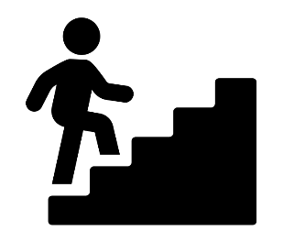

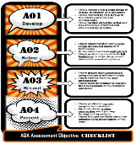


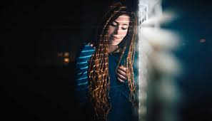
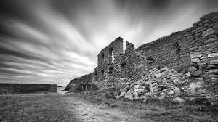
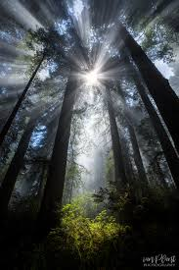
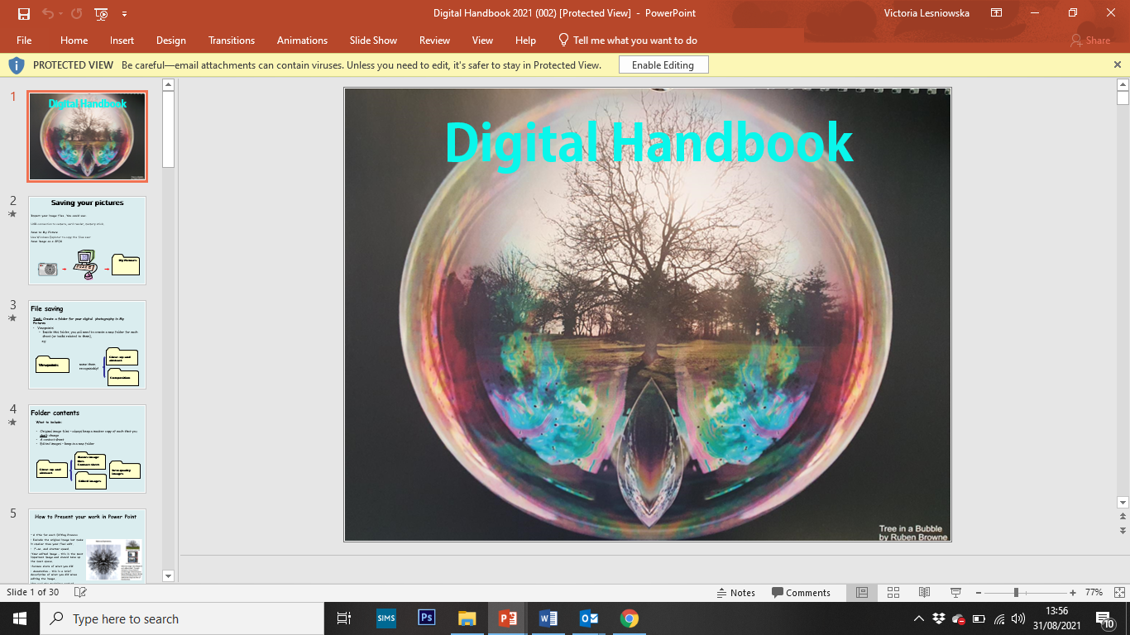

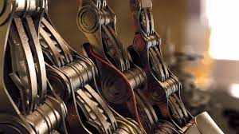
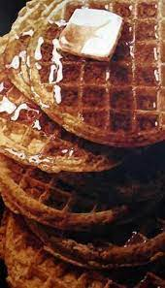
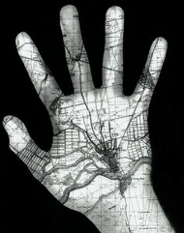

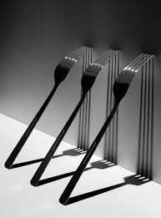
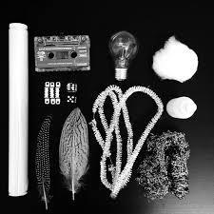
External Component 40% Exam
Exam paper given out
Observing and recording through own photographs
Planning of final outcomes for exam-working to students strengths
Final pieces produced, course work handed in and mounted
Discussion of exam paper – introduced February
Making sure assessment objectives are being developed and answered in preparatory work
External Exam -end of course
Discussion of final outcomes for courses work-working to students strengths
Structure of essay to run alongside personal project
Past examples given out
Summer work set , continuation of personal project and preparing for conclusions to personal project.
Students working though assessment feedback ensuring assessment objectives are answered.
Interview ready-portfolio
How to present a portfolio of work answering the 4 assessment objectives. Presentation and mounting up.
YEAR
How to present a portfolio of work-presentation and mounting up.
13
Continue to work on personal project
Summer work
presented
Developing
Personal projects to ensure experimentation
Course Introduction, breakdown of course, introducing of A 'Level assessment objectives. 60% coursework, 40% Exam
Observing and recording through own photographs
Developing understanding of how to develop ideas, experiment with materials and review work, and to record from it.
External Exam -end of GCSE course
Term 1 workshop based - Darkroom and digital. Linking to the theme of 'Growth and Decay'
YEAR
12
Making sure assessment objectives are being developed and answered
Planning of final outcomes for courses work-working to students strengths
Growth and Decay
Black and white darkroom film
Discussion of final outcomes for courses work-working to students strengths
Personal projects introduced
January
Observing and recording of photographs for chosen exam question
Experimenting with different digital processes as well as darkroom and physical manipulation
Developing portfolio, building on strengths
Discussion of exam paper
All coursework completed handed in January
External Component 40% Exam
Exam paper given out
Continuation of Project 2
Completion of final pieces for Course work
Discussion of final outcomes for courses work-working to students strengths
Observing and recording through own photographs
Developing understanding of assessment objectives
11
Project One- Pattern, Line and Texture. September- February
Starting point. Completion of Photoshop basic skills booklet through a PP document. Students are to use their own images relating to the theme
Introduction to digital editing techniques using photoshop- cropping/ hue and saturation/ black/ white / colour popping
Research/Investigate photographers inspired by selected theme
Fragments of Objects
10
Course Introduction, breakdown of course, introducing of GCSE assessment objectives. 60% coursework, 40% Exam
Pin- hole cameras
B/W-Darkroom
Completion of darkroom techniques
Solargrams, Photograms, Projectorgram, Stencils, Photo graffiti, Development of acetates. .
Darkroom artist investigated/research
2nd project
February- December
Choice of themes
‘Photography encourages children to think, developing skills and confidence as they go. ’
‘Photography encourages children to think, developing skills and confidence as they go. ’

